Slide 1
WoT Graph as Multiscale Digital Twin for Cyber-Physical
Systems-of-Systems
  Dr. G. Privat
  Orange Labs, Grenoble, France
2nd W3C Web of Things Workshop
June 3-5, 2019
Munich

Slide 2
Outline
Viewing the Web of Things as a Graph to capture Complex systems environments
Starting points :
    REST (HATEOAS) graph of WoT nodes as hyperlinked resources
    Graph nodes as Digital Twins of connected devices and non-connected things
    Structural composition graphs as Digital Twins of Cyber-Physical Systems and Systems of Systemsmposition
Property graphs as relevant meta-model for CPSS /WoT graph
        Links in the graph match physical connections, are not purely informational abstractions
        CPSS structural graph have an « analog » semantics of their own
System composition as an overlay property graph
Semantic referencing is a complementary overlay RDF graph

Slide 3
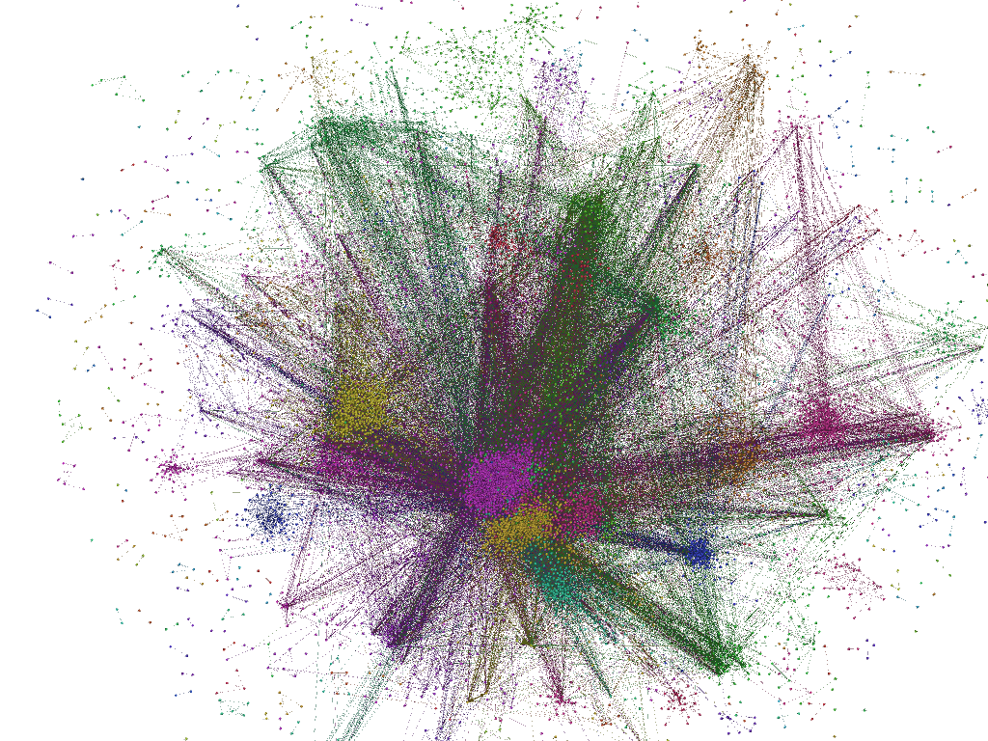
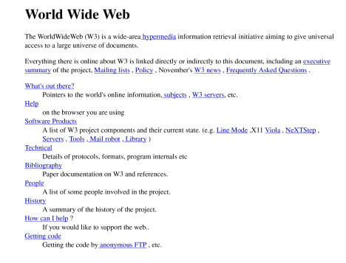
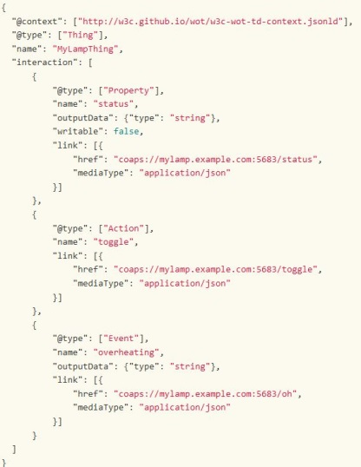
Wiewing the WoT as a graph
From : to :
From : to :
DUL:PhysicalObject
DUL:
InformationEntity
Overall
CityGraph
RDFS:SubClassOf
OneM2M:
device
OneM2M:
thing
NGSI-LD:
graph
Overall
Building Graph
isSub
GraphOf
RDF:type
42
isSub
GraphOf
isSub
GraphOf
hasAvailabilities
SOSA:Sensor
SOSA:
actuation
Building Security System Graph
ParkingAggregation
SystemS1
Graph
Sosa:
observes
isNodeOf
Graph
createdAt
Building Structure Graph
ApartmentGraph
Building
ParkingGraph
ParkingLot
Graph
2019/01/01
isNodeOf
Graph
(Outdoor)
CameraC1
AlarmA1
isContainedIn
ConstructedAt
isNodeOf
Graph
isNodeOf
Graph
isNodeOf
Graph
isNodeOf
Graph
BuildingA
1865/01/01
Parking
Lot L1
ElectronicGateLockEG1
actuates
hasPart
Parking
GarageG1
hasPart
Apartment A
Gate
G1
hasPart
Place PA1
FireSensorFS1
hasPart
available
Place PL3
isContainedIn
Room R1
Place PG2
Y/N
available
monitors
isContainedIn
LiveBox B1
isContainedIn
Parking
Lot L2
Place PL2
Y/N
LED LightL1
TeddyBear
hasPart

Slide 4


3 foundations for the WoT as a graph
1 hyperlinks (hypermedia controls) between thing resources make up graph
2 nodes as Digital Twins of connected devices and non-connected entities
3 structural CPS description as a graph and digital twin at system level
From : to :

Slide 5
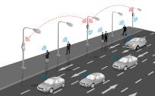




Simple CPS graph example
y% congested
hasState
Street A
ConnectsTo
Crossing AB
ConnectsTo
Alley B
70%
hasCoverage
monitors
controlledBy
isActuatorFor
Surveillance
Camera A1
Traffic Light TL1
Retractable
Bollard B1
hasState
hasState
Red/Yellow/Green
Open/closed

Slide 6
System composition as overlay graph
Traffic-lights control System Graph
isNodeOf
Graph
red
hasState
Traffic Light TL1
70%
y% congested
Traffic management System Graph
Surveillance
Camera A1
hasCoverage
hasState
actuatedBy
monitors
Street A
connectsTo
Traffic
Management
System
Crossing
isSub
GraphOf
isNodeOf
Graph
open/
closed
hasState
connectsTo
Empty/
Occupied
isNodeOf
Graph
Parking A
Contains
hasState
hasState
handicapped
parking space AH1
n/N available spaces
Empty/
Occupied
EV fast charger
Parking Management
System
hasState
Contains
Parking
management System Graph
EV charging
space AE1
hasPower
Smart City
System Graph

Slide 7

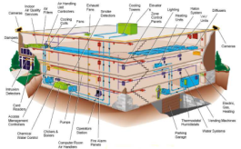
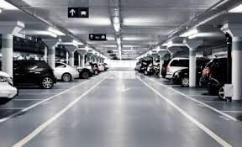
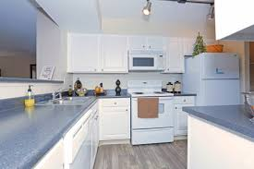
Representing nested
Cyber-Physical Systems of Systems
Capturing different system composition levels in complex environments
    the building is inside the city, but building entities are not directly city entities
    the apartment is inside the building, but home entities are not directly building entities
  Distinguish different views of same physical « plant »
    Supports management of privacy, security & legal ownership issues with corresponding data
Smart City
Traffic light L1
hasState
red
70%
congested
Controls
hasCoverage
hasState
Crossing C1
CameraC2
monitors
Street S1
adjacentTo
opensOnto
opensOnto
Building Security System
B
Building
ElectricGateEG1
BuildingA
AlarmA1
CameraC1
hasPart
hasPart
Parking
Lot L1
Place PA2
n/N
FireSensorFS1
hasPart
Apartment A
hasPart
Place PA1
hasAvailabilities
hasPart
hasPart
hasPart
available
ParkingAggregation
SystemS1
LiveBox B1
Room R1
Parking
GarageG1
Y/N
hasPart
Parking Garage
Parking Management
System
LED LightL1
Washing MachineW1
Apartment

Slide 8
Traffic light L1
hasState
red
Smart City Graph
70%
congested
Controls
hasCoverage
hasState
monitors
adjacentTo
Crossing C1
opensOnto
CameraC2
Street S1
opensOnto
Building Security System Graph
B
Building Structural
Graph
BuildingA
ElectricGateEG1
hasPart
hasPart
AlarmA1
CameraC1
Place PA2
Parking
Lot L1
Apartment A
hasPart
Place PA1
n/N
FireSensorFS1
hasAvailabilities
isContainedIn
hasPart
hasPart
available
ParkingAggregation
SystemS1
isContainedIn
Parking
GarageG1
Y/N
LiveBox B1
Room R1
Parking Garage
Graph
Parking Management
System Graph
isContainedIn
Washing MachineW1
LED LightL1
Apartment Graph

Slide 9
Semantic referencing (knowledge graph proper) as an overlay on CPSS graph
DUL:PhysicalObject
DUL:
InformationEntity
NGSI-LD:
graph
SOSA:Sensor
SOSA:Actuator
red
Traffic-lights control System Graph
hasState
Traffic Light TL1
70%
y% congested
isNodeOf
Graph
Surveillance
Camera A1
hasCoverage
hasState
actuatedBy
Traffic management System Graph
monitors
Street A
connectsTo
Traffic
Management
System
Crossing
isNodeOf
Graph
open/
closed
isSub
GraphOf
Smart City
System Graph
hasState
connectsTo
Empty/
Occupied
isNodeOf
Graph
Parking A
Contains
hasState
Parking
management System Graph
hasState
handicapped
parking space AH1
n/N available spaces
Parking Management
System
Empty/
Occupied
EV fast charger
hasState
Contains
hasPower
EV charging
space AE1

Slide 10

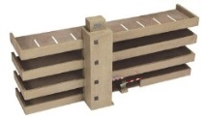
Ontology graph
thoroughfare
to class)
parking structure
subClassOf
subClassOf
street
parking Lot
Semantic Referencing Graph
instantiates
System Twin graph
Traffic Lights
graph
refers to
refers to
Parking management
graph
Trafic management System graph
Things Twin graph
Street S1
Traffic Light TL1
Parking lot PL1
Referent Physical Entities
stands for

Slide 11
Thanks

Slide 12
Characterizing « systems of systems »
A system of systems is the aggregation of multiple subsystems which:
    are heterogeneous
    are in dynamical interaction between each other
    jointly provide an overall functionality which is more than the sum of their individual functionalities
    are independently operated
    have their own function, independent from that of the overall system
    are independently designed
    are (usually) physically distributed

Slide 13
Top-down vs bottom-up composition for classical (non-distributed) systems
Classical System
Bottom-up
System comp.
“Loose” System
Building
Top-Down
System comp.
Room A
hasPart
isContainedIn
Apartment A2
Apartment A1
LiveBox
Washing Machine
hasPart
Room R1
Room R2
Description of Room
as a system
Neither LiveBox nor Washing Machine
are inherent parts of Room
Description of Building Structure
as nested systems
“Apartment is inherent part of Building
are inherent parts of “Laptop B”.

Slide 14
Top-down vs bottom-up composition for
(distributed) systems of systems
ParkingAggregation
System
Graph
Bottom-up
System comp.
Building Security System Graph
Top-Down
System comp.
isNodeOf
Graph
isNodeOf
Graph
AlarmA1
(Outdoor)
CameraC1
Place PA1
ElectronicGateLockEG1
available
Place PL3
Y/N
available
Y/N
FireSensorFS1
Place PL2
Parking aggregation system
Building Security System”

Slide 15

DUL:PhysicalObject
DUL:
InformationEntity
Overall
CityGraph
RDFS:SubClassOf
RDF:type
OneM2M:
thing
NGSI-LD:
graph
isSub
GraphOf
OneM2M:
device
Overall
Building Graph
42
hasAvailabilities
isSub
GraphOf
isSub
GraphOf
Building Security System Graph
ParkingAggregation
SystemS1
Graph
SOSA:Sensor
SOSA:
actuation
createdAt
Building Structure Graph
Sosa:
observes
isNodeOf
Graph
Building
ParkingGraph
2019/01/01
ApartmentGraph
ParkingLot
Graph
isNodeOf
Graph
AlarmA1
isContainedIn
isNodeOf
Graph
isNodeOf
Graph
isNodeOf
Graph
isNodeOf
Graph
(Outdoor)
CameraC1
ConstructedAt
1865/01/01
Parking
Lot L1
ElectronicGateLockEG1
BuildingA
hasPart
actuates
Parking
GarageG1
Gate
G1
hasPart
Apartment A
hasPart
Place PA1
available
FireSensorFS1
hasPart
Place PL3
isContainedIn
Place PG2
Y/N
available
Room R1
Y/N
isContainedIn
isContainedIn
monitors
LiveBox B1
Parking
Lot L2
TeddyBear
Place PL2
LED LightL1
hasPart

Slide 16
Complementary Example :
graph for sharing & interlinking information
between 3 smart city operators →flattened view
OneWay/TwoWay
Traffic Management System
70%
y% congested
hasDirection
isConnectedTo
Surveillance
Camera A1
hasCoverage
hasState
Open/closed
monitors
Street A
actuatedBy
hasState
Retractable
Bollard B1
Alley B
Traffic Light TL1
isActuatorFor
hasOpening
IsConnectedTo
gate A
isAdjacentTo
Parking B Management
System
hasState
open/
closed
Empty/
Occupied
Inductive
sensor
Empty/
Occupied
Parking A
Contains
hasState
hasState
handicapped
parking space AH1
isSensorFor
hasState
parking space B
n/N available spaces
Empty/
Occupied
EV fast charger
isActuatorFor
Parking A Management
System
hasState
Contains
hasPower
Barrier B
EV charging
space AE1
P watts

Slide 17
Smart City
System Graph
isSub
GraphOf
may Override
Traffic management System Graph
Traffic-lights control System Graph
Parking A
management System Graph
Parking A
management System Graph
isNodeOf
Graph
isNodeOf
Graph
isNodeOf
Graph
isNodeOf
Graph
OneWay/TwoWay
70%
y% congested
hasDirection
Surveillance
Camera A1
hasCoverage
hasState
isConnectedTo
monitors
Street A
actuatedBy
Open/closed
hasState
Retractable
Bollard B1
Alley B
Traffic Light TL1
isActuatorFor
gate A
hasOpening
isAdjacentTo
IsConnectedTo
hasState
Inductive
sensor
open/
closed
Empty/
Occupied
Empty/
Occupied
Parking A
Contains
hasState
hasState
hasState
handicapped
parking space AH1
parking space B
isSensorFor
n/N available spaces
Empty/
Occupied
EV fast charger
isActuatorFor
hasState
Contains
hasPower
Barrier B
EV charging
space AE1
P watts

Slide 18
Complementary Example :
graph for sharing & interlinking information
between 3 smart city operators, viewed at the graph composition level
Smart City
System Graph
isSub
GraphOf
May Override
Traffic management System Graph
Parking A
management System Graph
Traffic-lights control System Graph
Parking A
management System Graph
isNodeOf
Graph
isNodeOf
Graph
isNodeOf
Graph
isNodeOf
Graph
OneWay/TwoWay
70%
y% congested
hasDirection
Surveillance
Camera A1
hasCoverage
hasState
isConnectedTo
monitors
Street A
actuatedBy
Open/closed
hasState
Retractable
Bollard B1
Alley B
Traffic Light TL1
isActuatorFor
gate A
hasOpening
isAdjacentTo
IsConnectedTo
hasState
Inductive
sensor
open/
closed
Empty/
Occupied
Empty/
Occupied
Parking A
Contains
hasState
hasState
hasState
handicapped
parking space AH1
parking space B
isSensorFor
n/N available spaces
Empty/
Occupied
EV fast charger
isActuatorFor
hasState
Contains
hasPower
Barrier B
EV charging
space AE1
P watts

Slide 19
Core ETSI CIM NGSI-LD Information model
rdfs:range
hasObject
hasValue
rdfs:range
Legend:
rdfs:subClassOf
Entity
Relationship
Property
Value
a (owl:DatatypeProperty)
Example
example
example
Example
API Constrained Vocabulary
Location
Temporal
Property Types
Value Types
Location
Relationship
LocationProperty
TimeInterval
Continuous
Value
Zone
Vector
Value
StateProperty
Static
Instantaneous
SemiStatic
Discrete
Value
has
Observation
Zone
Scalar
Value
Coordinate
BasedLocation
Temporal
Property
Continuous
Time
Discrete
Time
Measurement
Property
has
Operation
Zone
Mobility
GeoProperty
observedAt
hasTimeInterval
Stationary
createdAt
start
SAREF:
hasState
hasMeasure
unitCode
Movable
SetBased
Location
GraphBased
Location
location
end
Geometry
SAREF:
State
SAREF: Measurement
observationSpace
modifiedAt
Mobile
isContainedIn
connectsTo
operationSpace
Point
complementOf
LineString
Polygon

Slide 20
Extensions of ETSI CIM NGSI-LD Information model
for description of System composition
Property Graph Grounding [Core meta-model]
Value Types
Vector
Value
Continuous
Value
rdfs:range
hasObject
hasValue
rdfs:range
Discrete
Value
Scalar
Value
Entity
Relationship
Property
Value
domain: Entity
aux. prop.: hasObject
domain: Entity
aux. prop.: hasValue
Geometry
SAREF:State
System composition graph
Point
SAREF: Measurement
G-Entity
G-Relationship
G-Property
LineString
Polygon
domain: Entity/
Relationship/Property
domain: Entity/
Relationship/Property
System Composition
hasPart
hasDirectPart
System Composition Description
isNodeOfGraph
domain: Entity
range: Graph
Location
Temporal Description
Property Types
Graph
Location
Relationship
LocationProperty
time:Interval
StateProperty
isSubgraphOf
I-Temporal Description
time:Duration
domain: Graph
range: Graph
createdAt
time:Instant
modifiedAt
Zone
has
Observation
Zone
Continuous
Time
Discrete
Time
Coordinate
BasedLocation
Temporal
Property
has
Operation
Zone
SAREF:hasState
Mobility
GeoProperty
observedAt
hasTimeInterval
Stationary
time:hasBeginning
Static
Instantaneous
SemiStatic
Movable
SetBased
Location
GraphBased
Location
location
time:hasEnd
observationSpace
time:hasDuration
Measurement
Property
reliability
Mobile
isContainedIn
connectsTo
operationSpace
complementOf
hasMeasure
unitCode

